Slide 1
Database
Data Mining

Slide 2
Data Mining
Objective:
  To find non-trivial interesting patterns from a large amount of information stored in databases

Slide 3
Data Mining
Used in
  Decision Making
    Customer Relationship Management (CRM)
      To design methods to interact with customers
    Enterprise Resource Planning (ERP)
      To manage all the information and functions of a business or company from databases

Slide 4
Major Topics
Association
Clustering
Classification

Slide 5
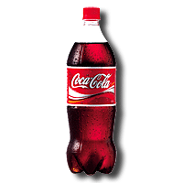
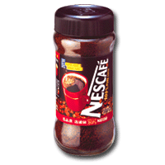
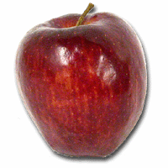
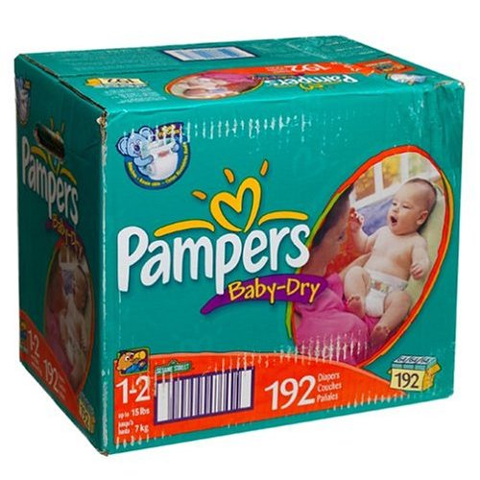
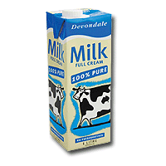
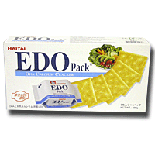
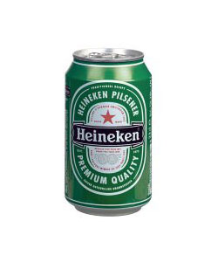
1. Association
Supermarket Application
Item
History or Transaction
Raymond
apple
coke
coffee
David
…
We want to find some associations between items.
diaper
coke
An interesting association:
Diaper and Beer are usually bought together.
Emily
…
milk
biscuit
Why? Is it strange?
Derek
…
coke
milk
diaper
beer

Slide 6
1. Association
Supermarket Application
An interesting association:
Diaper and Beer are usually bought together.
Why? Is it strange?
diaper
beer

Slide 7
1. Association
An interesting association:
Diaper and Beer are usually bought together.
Why? Is it strange?
Supermarket Application
diaper
beer
Reasons:
This pattern occurs frequently in the early evening.
Daytime
Office
Working…

Slide 8
1. Association
An interesting association:
Diaper and Beer are usually bought together.
Why? Is it strange?
Supermarket Application
diaper
beer
Reasons:
This pattern occurs frequently in the early evening.
Early Evening
Morning
Office
Home
Please buy diapers

Slide 9
1. Association
Customer | Apple | Orange | Milk
Raymond | Apple | Orange
Ada |  | Orange | Milk
Grace | Apple | Orange
… | … | … | …
We are interested in the items/itemsets with frequency >= 2
Items/Itemsets | Frequency
Apple | 2
Orange | 3
Milk | 1
{Apple, Orange} | 2
{Orange, Milk} | 1
Frequent Pattern
(or Frequent Item)
Frequent Pattern
(or Frequent Item)
Frequent Pattern
(or Frequent Itemset)

Slide 10
1. Association
Customer | Apple | Orange | Milk
Raymond | Apple | Orange
Ada |  | Orange | Milk
Grace | Apple | Orange
… | … | … | …
We are interested in the items/itemsets with frequency >= 2
Association Rule:
1. Apple → Orange
( customers who buy apple will probably buy orange.)
2. Orange → Apple
( customer who buy orange will probably buy apple.)
Items/Itemsets | Frequency
Apple | 2
Orange | 3
Milk | 1
{Apple, Orange} | 2
{Orange, Milk} | 1
100%
2
3
67%
2
2
Problem: to find all frequent patterns and association rules

Slide 11
Major Topics
Association
Clustering
Classification

Slide 12
2. Clustering
Cluster 2
(e.g. High Score in History
and Low Score in Computer)
History
 | Computer | History
Raymond | 100 | 40
Louis | 90 | 45
Wyman | 20 | 95
… | … | …
Cluster 1
(e.g. High Score in Computer
and Low Score in History)
Computer
Problem: to find all clusters

Slide 13
Major Topics
Association
Clustering
Classification

Slide 14
3. Classification
Suppose there is a person.
Race | Income | Child | Insurance
white | high | no | ?
root
child=yes
child=no
100% Yes
0% No
Income=high
Income=low
100% Yes
0% No
0% Yes
100% No
Decision tree

